Slide 1
Gauss’ Law
Key contents
Electric flux
Gauss’ law and Coulomb’s law
Applications of Gauss’ law

Slide 2
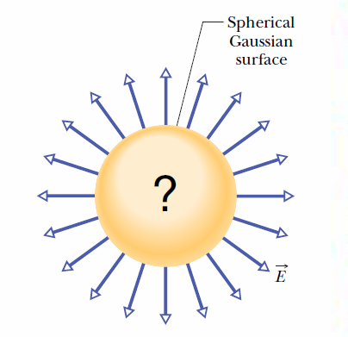
Gauss’ law relates the electric fields at points on a (closed) Gaussian surface to the net charge enclosed by that surface.
Consider the flux passing through a closed surface and the amount of charge inside.

Slide 3
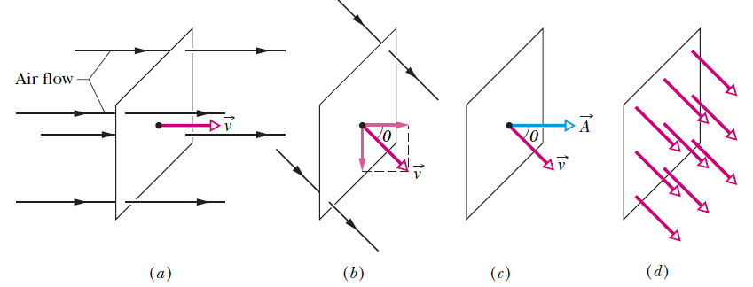

Flux
Fig. 23-2 (a) A uniform airstream of velocity is perpendicular to the plane of a square loop of area A. (b) The component of perpendicular to the plane of the loop is v cos θ, where θ is the angle between v
and a normal to the plane. (c) The area vector A is perpendicular to the plane of the loop and makes an angle θ with v. (d) The velocity field intercepted by the area of the loop. The rate of volume flow through the loop is Φ= (v cos θ)A.
This rate of flow through an area is an example of a flux—a volume flux in this situation.
# The actual physical quantity referred to by the term ‘flux’ can be different in different occasions.

Slide 4
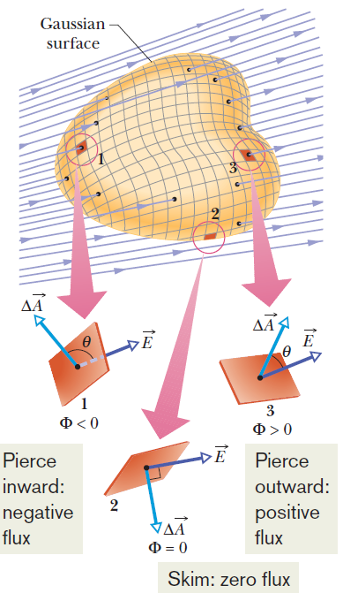

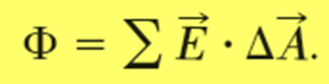
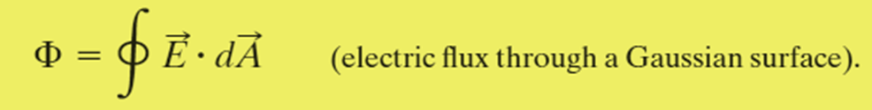
Electric Flux
The electric flux through a surface is defined to be the inner product of the electric field and the surface vector:
For a closed surface, it is

Slide 5
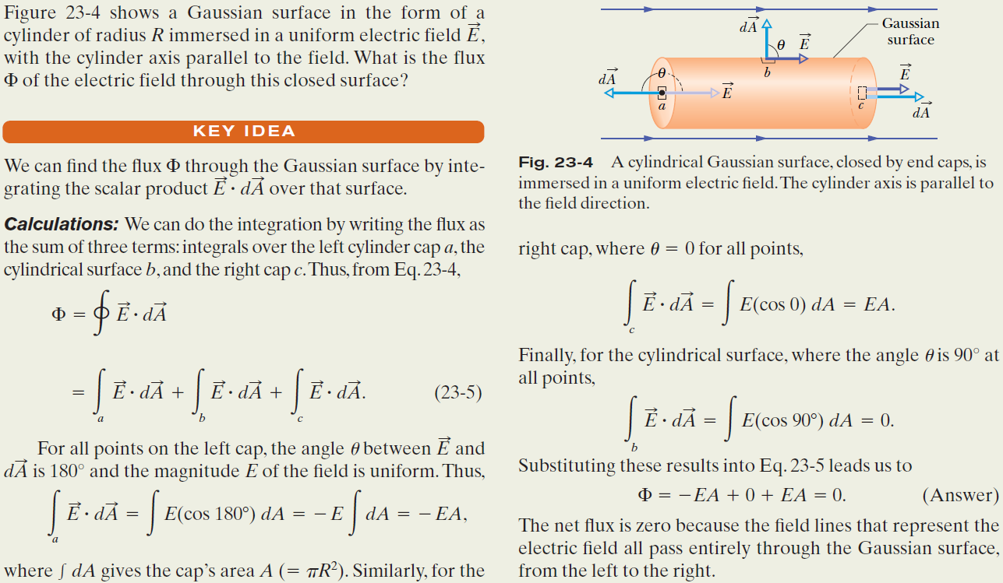
Example, Flux through a closed cylinder, uniform field:

Slide 6
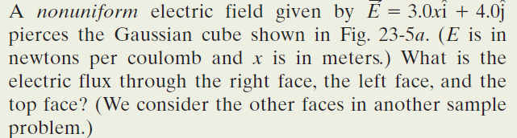
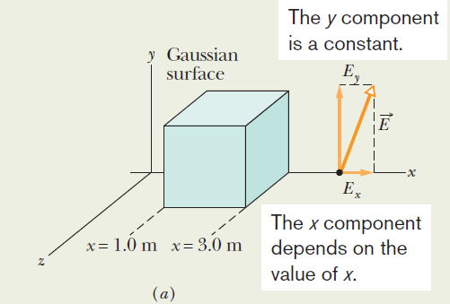

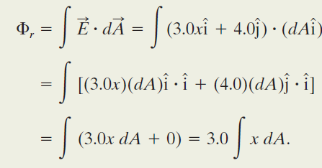


Example, Flux through a closed cube,
Non-uniform field:
Right face: An area vector A is always perpendicular to its surface and always points away from the interior of a Gaussian surface. Thus, the vector for any area element dA (small section) on the right face of the cube must point in the positive direction of the x axis. The most convenient way to express the vector is in unit-vector notation,
Although x is certainly a variable as we move left to right across the figure, because the right face is perpendicular to the x axis, every point on the face has the same x coordinate. (The y and z coordinates do not matter in our integral.) Thus, we have

Slide 7
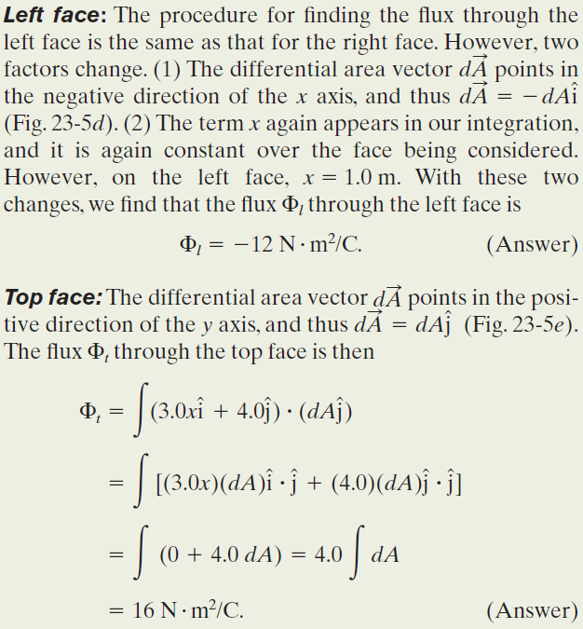
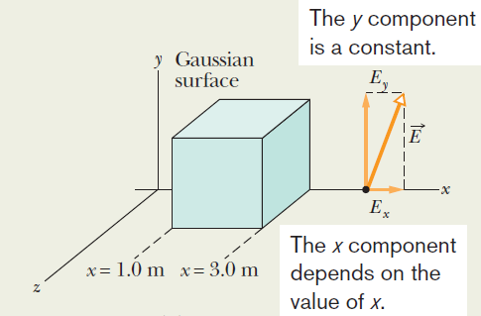
Example, Flux through a closed cube,
Non-uniform field:

Slide 8
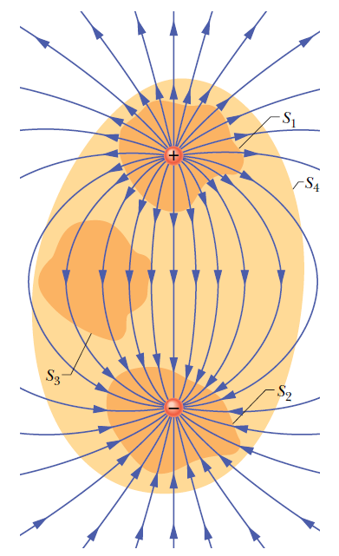
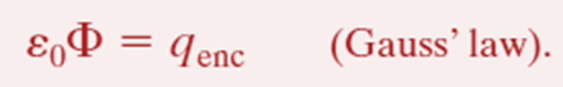
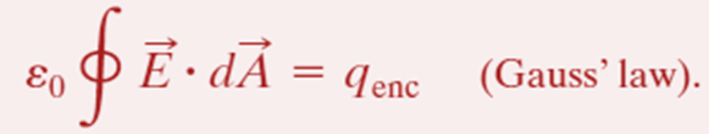
Gauss’ Law:
The net charge q_{enc} is the algebraic sum of all the enclosed positive and negative charges, and it can be positive, negative, or zero.
The electric field at the surface is due to all the charge distribution, including both that inside and outside the surface.

Slide 9
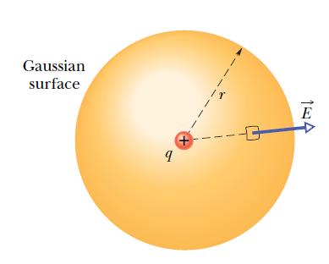


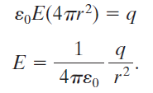
Gauss’ Law and Coulomb’s Law:
One may also derive Gauss’ law from Coulomb’s law.
These two laws are equivalent.

Slide 10
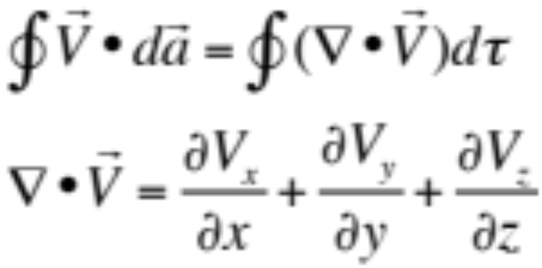
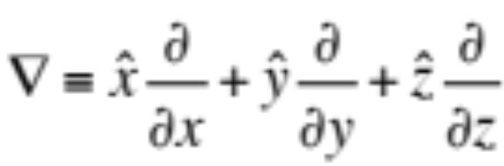
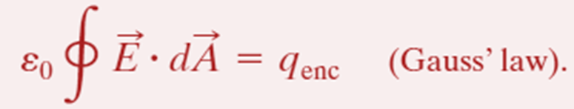
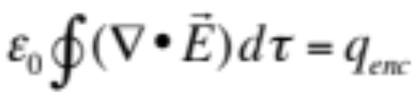

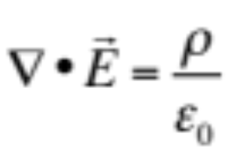
(Gauss theorem in vector analysis)
(Gauss’ law in differential form)

Slide 11
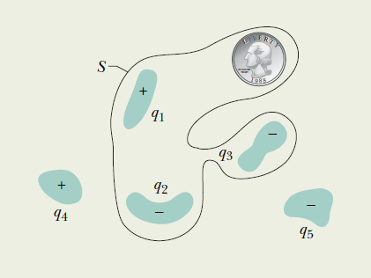
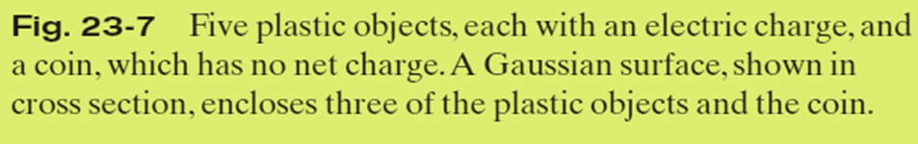
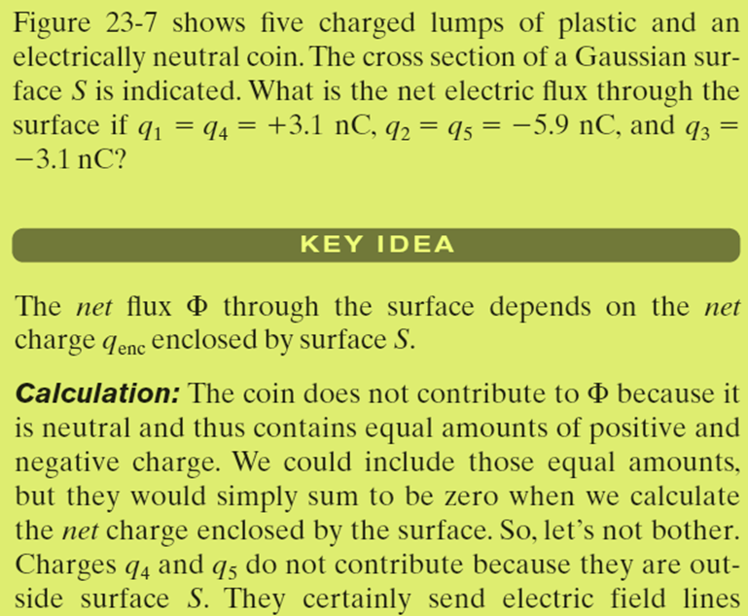
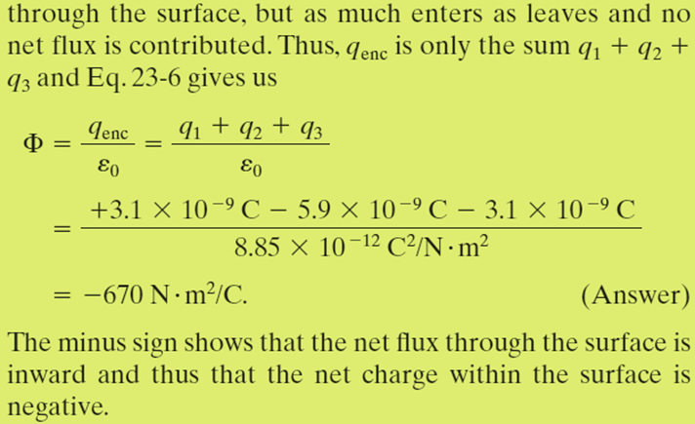
Example, Relating the net enclosed charge and the net flux:

Slide 12
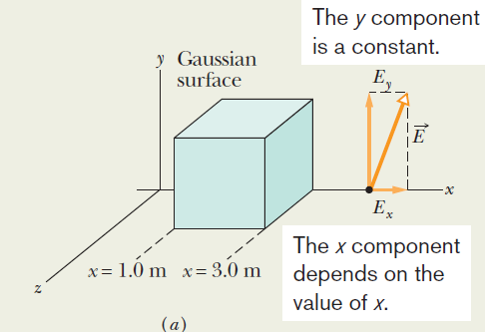
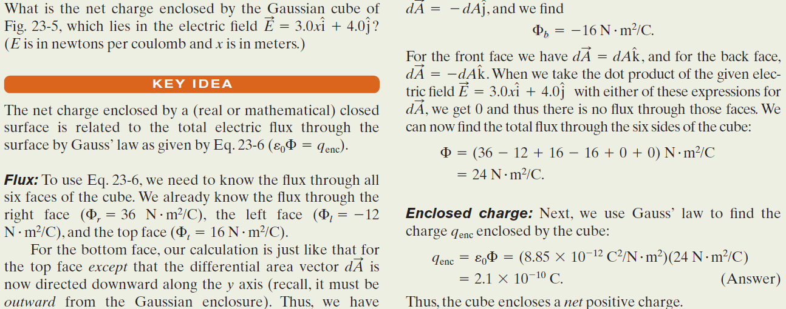
Example, Enclosed charge in a
non-uniform field:

Slide 13
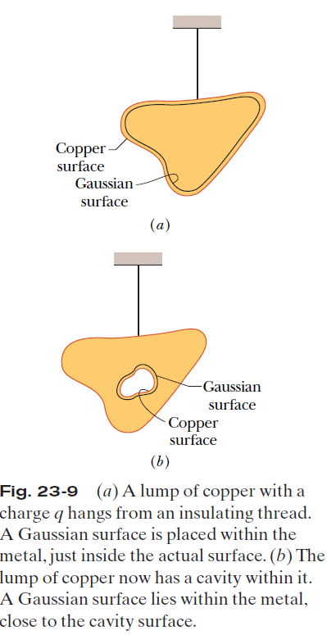
23.6 A Charged Isolated Conductor:
If an excess charge is placed on an isolated conductor, that amount of charge will move entirely to the surface of the conductor. None of the excess charge will be found within the body of the conductor.
Figure 23-9a shows, in cross section, an isolated lump of copper hanging from an insulating thread and having an excess charge q. The Gaussian surface is placed just inside the actual surface of the conductor. The electric field inside this conductor must be zero. Since the excess charge is not inside the Gaussian surface, it must be outside that surface, which means it must lie on the actual surface of the conductor.
Figure 23-9b shows the same hanging conductor, but now with a cavity that is totally within the conductor. A Gaussian surface is drawn surrounding the cavity, close to its surface but inside the conducting body. Inside the conductor, there can be no flux through this new Gaussian surface. Therefore, there is no net charge on the cavity walls; all
the excess charge remains on the outer surface of the conductor.

Slide 14
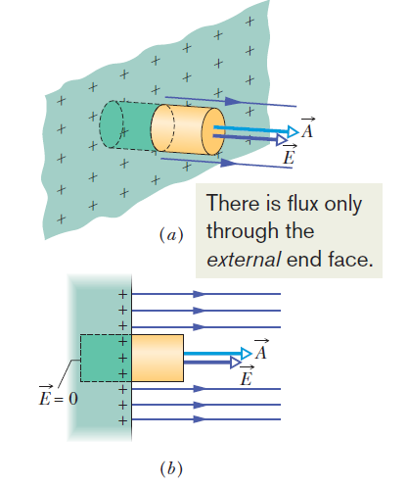

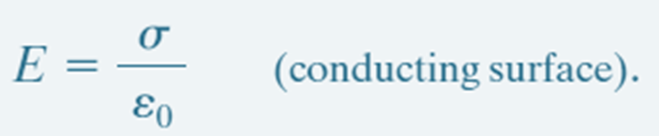
A Charged Isolated Conductor; The External Electric Field:
is the charge per unit area.
q_{enc} is equal to σA.

Slide 15
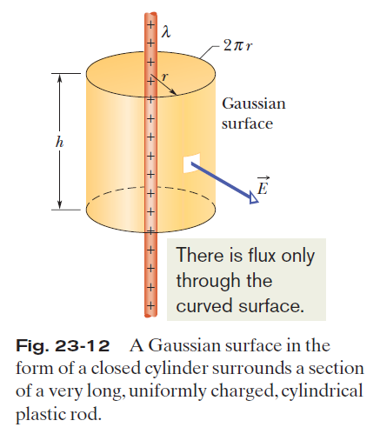
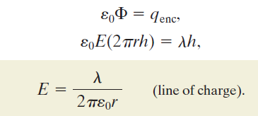
Applying Gauss’ Law and Cylindrical Symmetry:

Slide 16
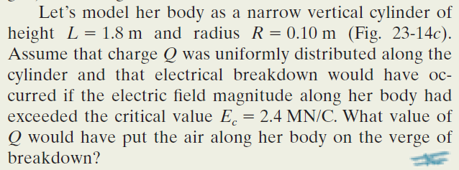
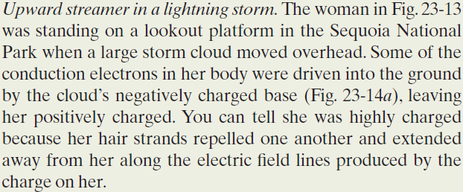
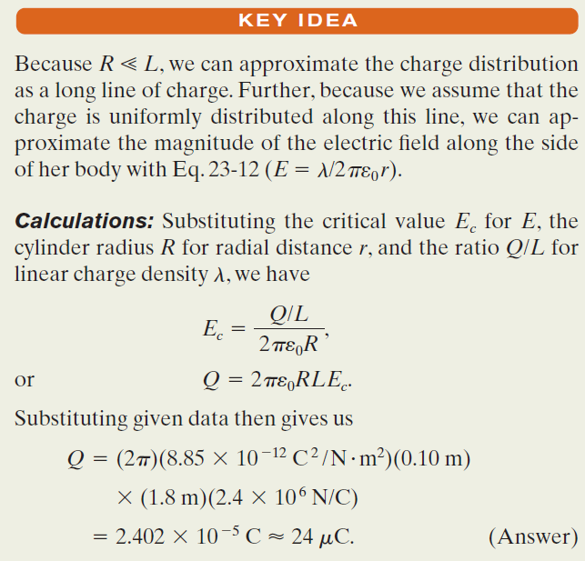
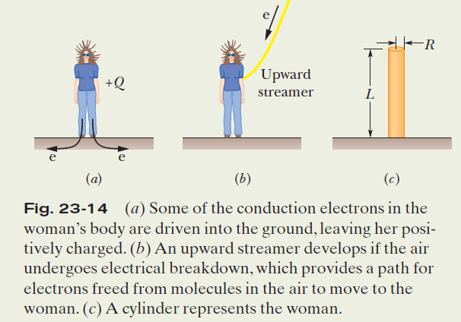
Example, Gauss’ Law and an
upward streamer in a lightning storm:

Slide 17
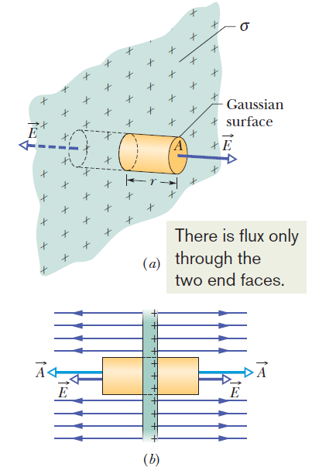
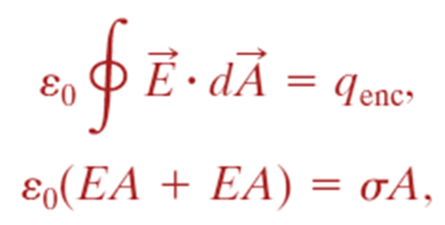
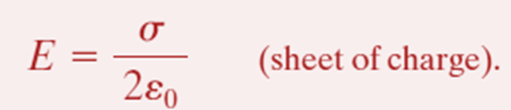
Applying Gauss’ Law, Planar Symmetry
Non-conducting Sheet:

Slide 18
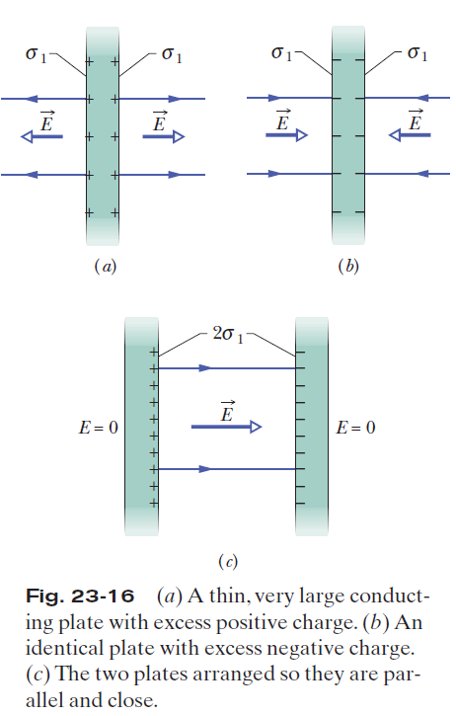
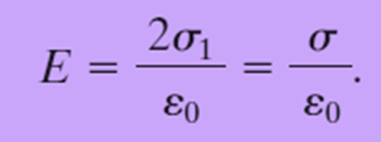
23.8 Applying Gauss’ Law, Planar Symmetry
Two Conducting Plates:

Slide 19
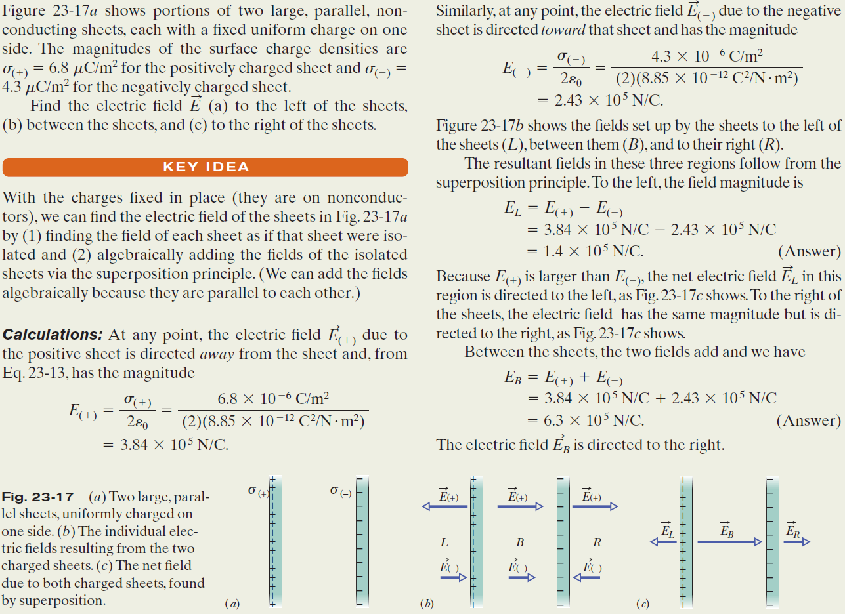
Example, Electric Field:

Slide 20
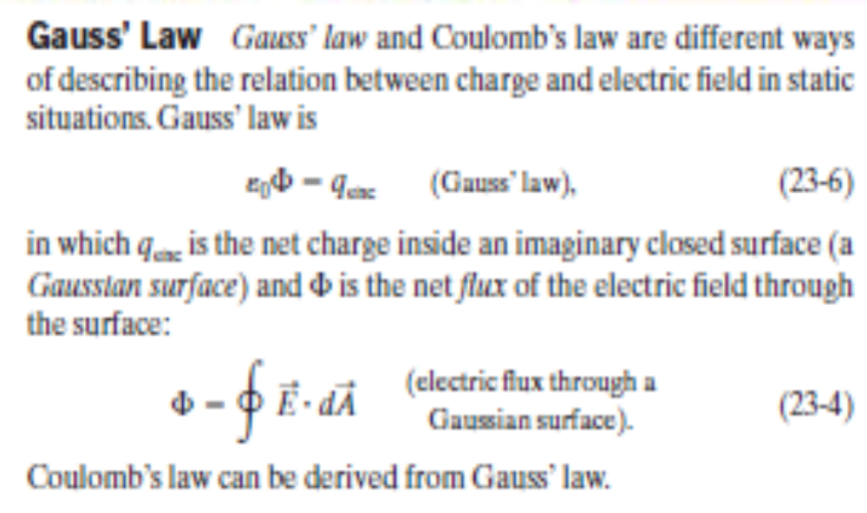


Slide 21
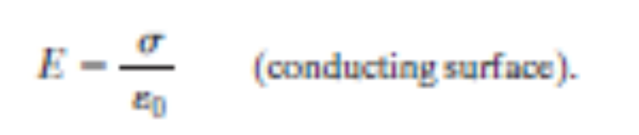
Applications of Gauss’ Law
Using Gauss’ law and, in some cases, symmetry arguments, we can derive several important results in electrostatic situations. Among these are:
An excess charge on an isolated conductor is located entirely on the outer surface of the conductor.
The external electric field near the surface of a charged conductor is perpendicular to the surface and has magnitude
Within the conductor, E=0.

Slide 22
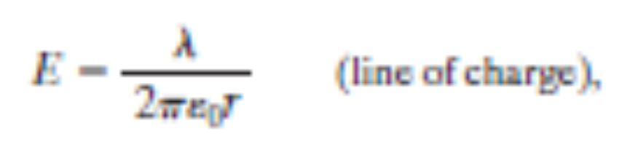
The electric field at any point due to an infinite line of charge with uniform linear charge density l is perpendicular to the line of charge and has magnitude
where r is the perpendicular distance from the line of charge to the point.

Slide 23
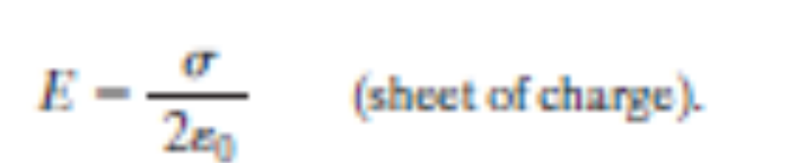
The electric field due to an infinite non-conducting sheet with uniform surface charge density s is perpendicular to the plane of the sheet and has magnitude

Slide 24
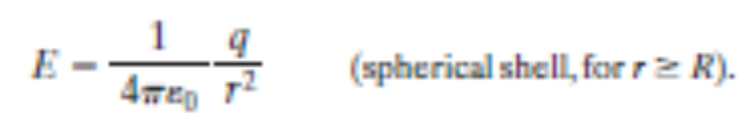
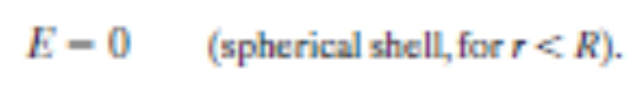
The electric field outside a spherical shell of charge with radius R and total charge q is directed radially and has magnitude
Here r is the distance from the center of the shell to the point at which E is measured. (The charge behaves, for external points, as if it were all located at the center of the sphere.) The field inside a uniform spherical shell of charge is exactly zero:

Slide 25
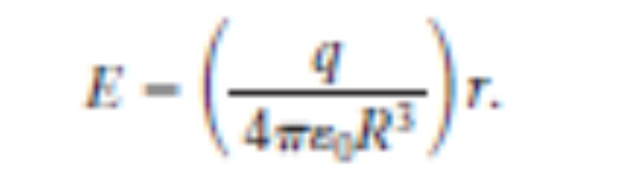
The electric field inside a uniform sphere of charge is directed radially and has magnitude

Slide 26
